Slide 1

TEMPORAL LOGIC
Models & Programs
Notes:
1

Slide 2
Contents
Using temporal logic to represent simple system behaviors
Understand temporal semantics for a basic imperative programming language

Slide 3
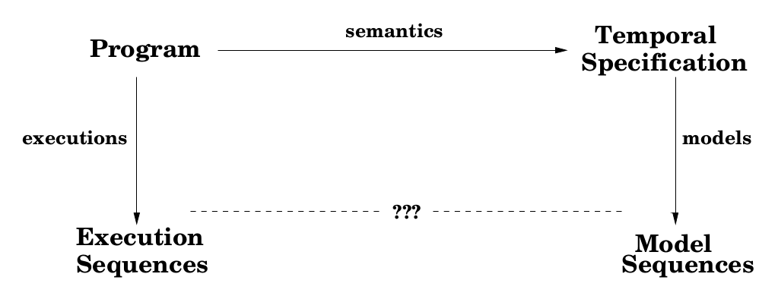
OVERVIEW

Slide 4
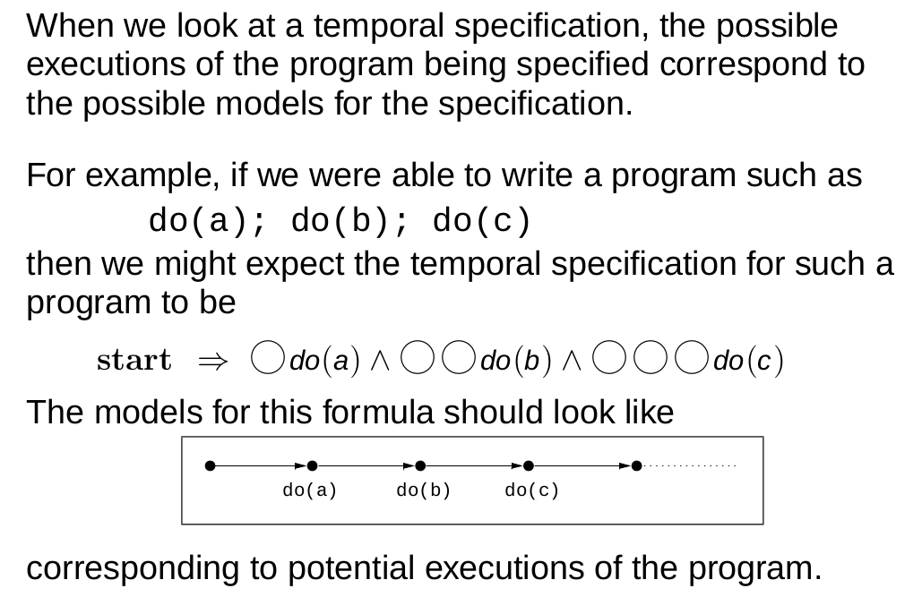
INTERPRETING TEMPORAL FORMULA
Notes:
1

Slide 5
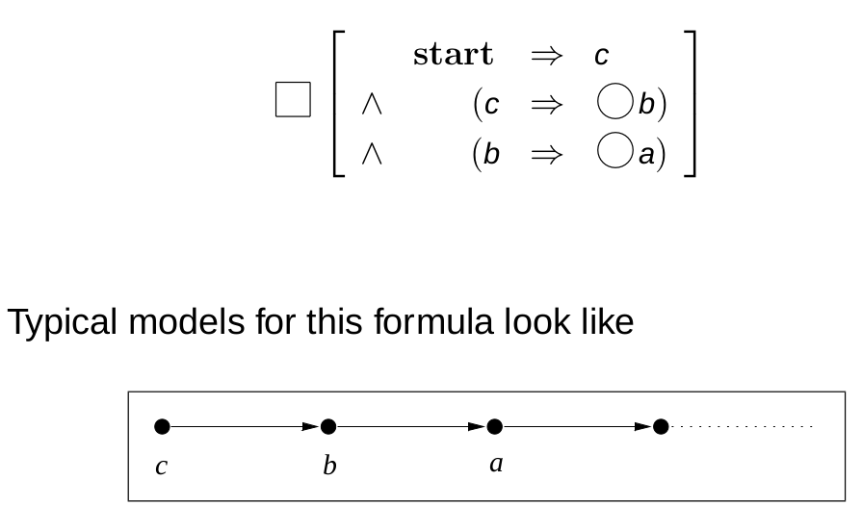
TEMPORAL SPECIFICATION
Consider the following abstract temporal specification as follows
Typical Model for this formula will look like as:

Slide 6
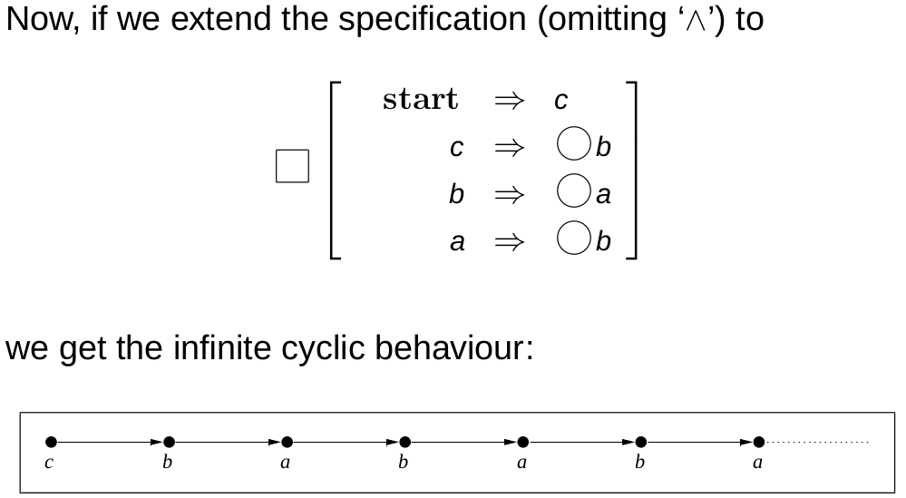
TEMPORAL SPECIFICATION

Slide 7
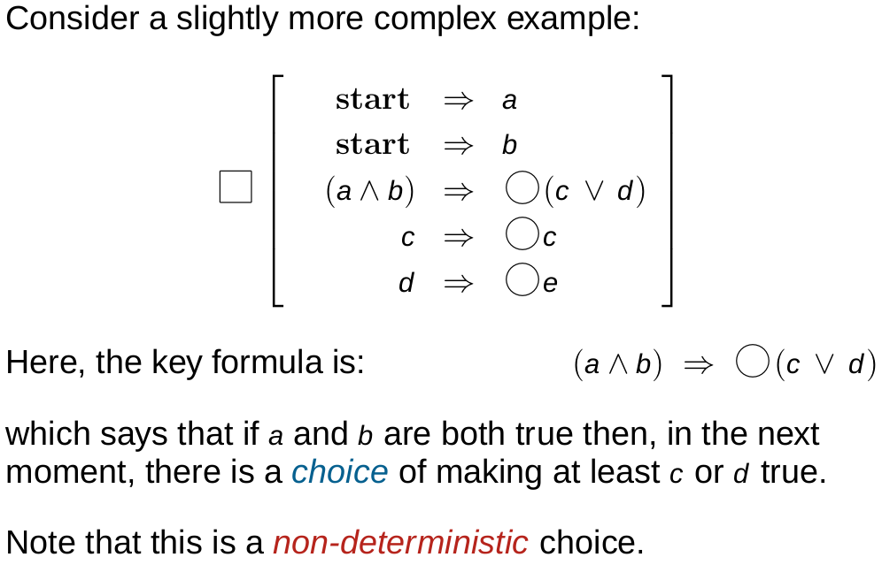
TEMPORAL SPECIFICATION

Slide 8
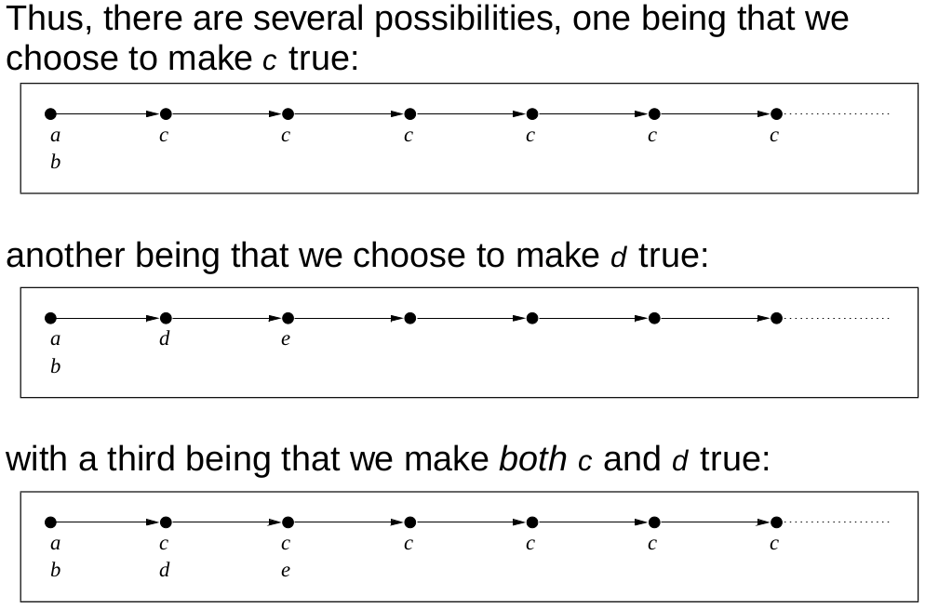
MODELS FOR LAST EXAMPLE

Slide 9
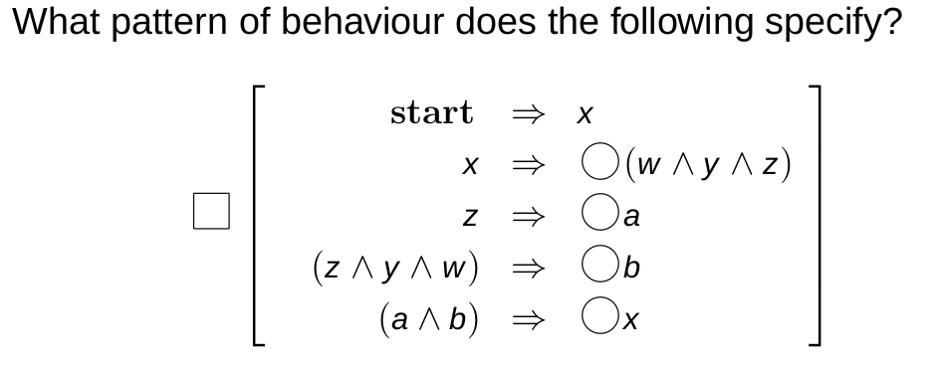
EXERCISE

Slide 10
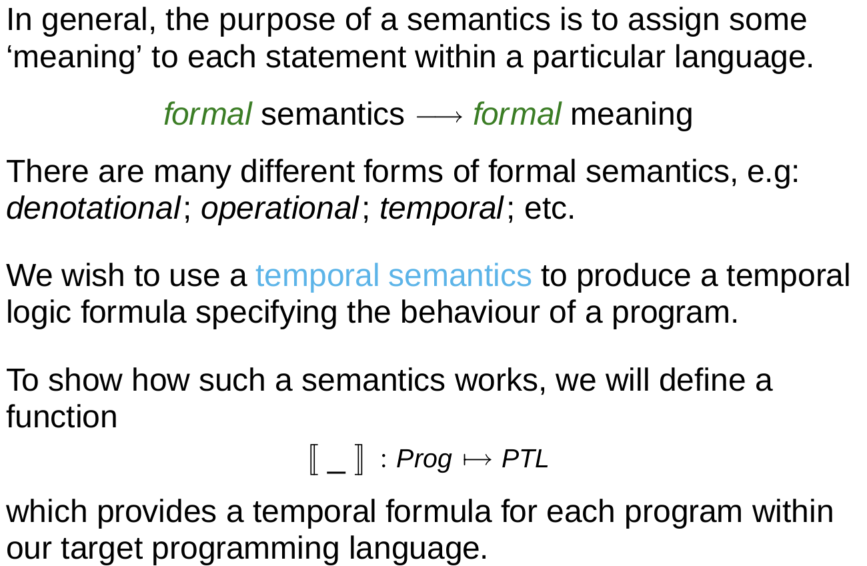
REPRESENTING PROGRAMS

Slide 11
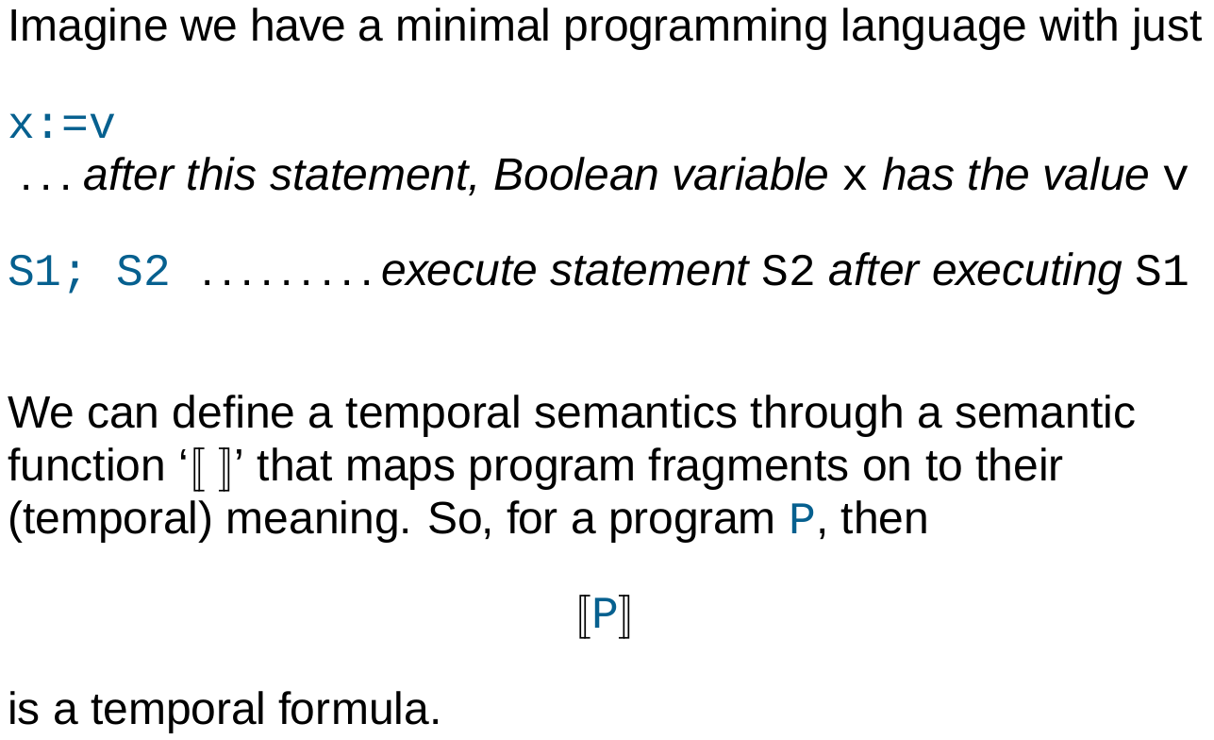
BOOLEAN ASSIGNMENTS

Slide 12
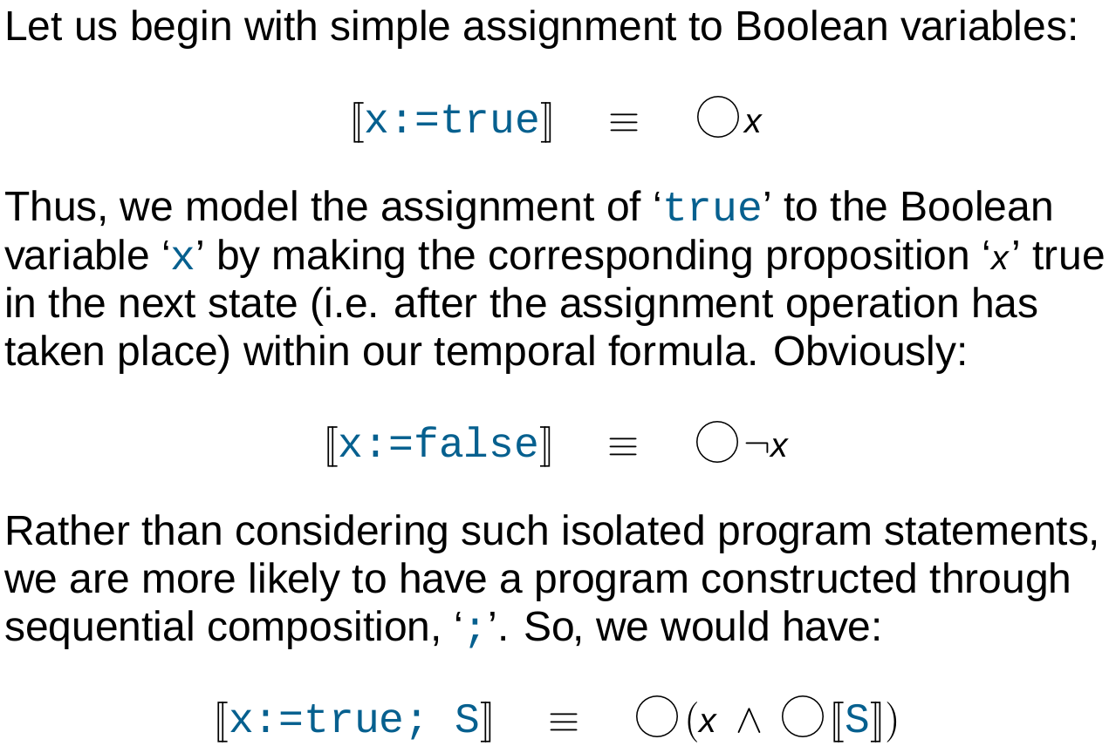
SEMANTICS OF BOOLEAN ASSIGNMENT
Notes:
1

Slide 13
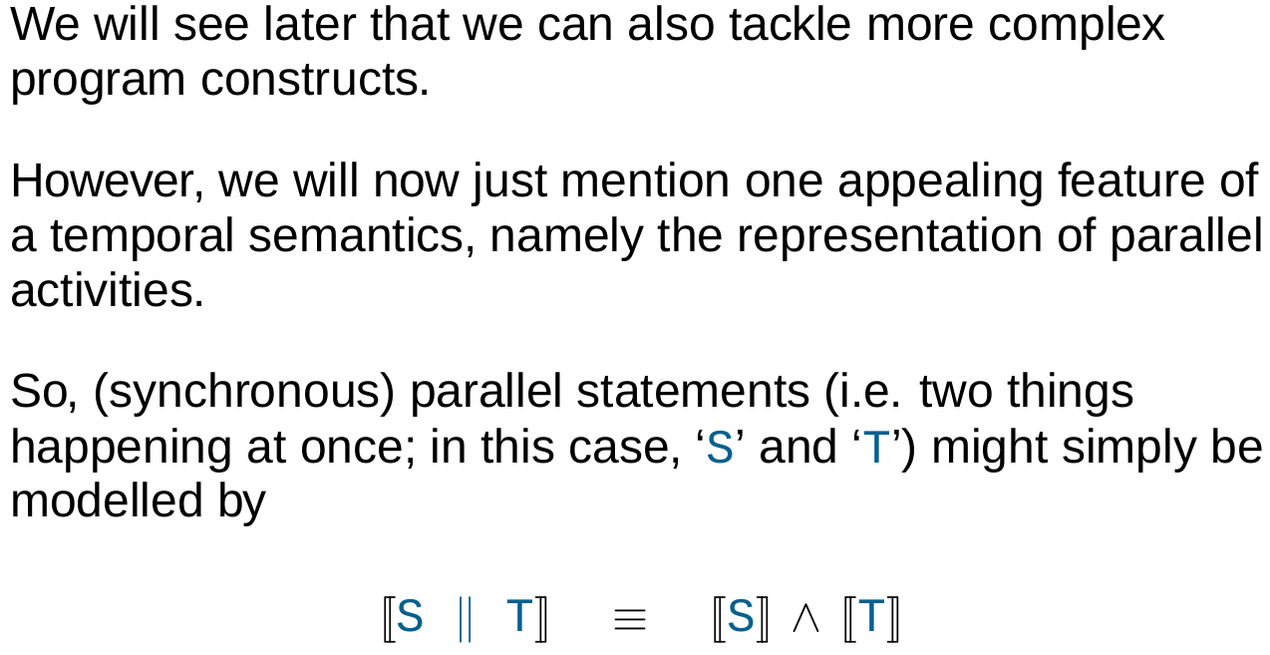
CONCURRENCY

Slide 14
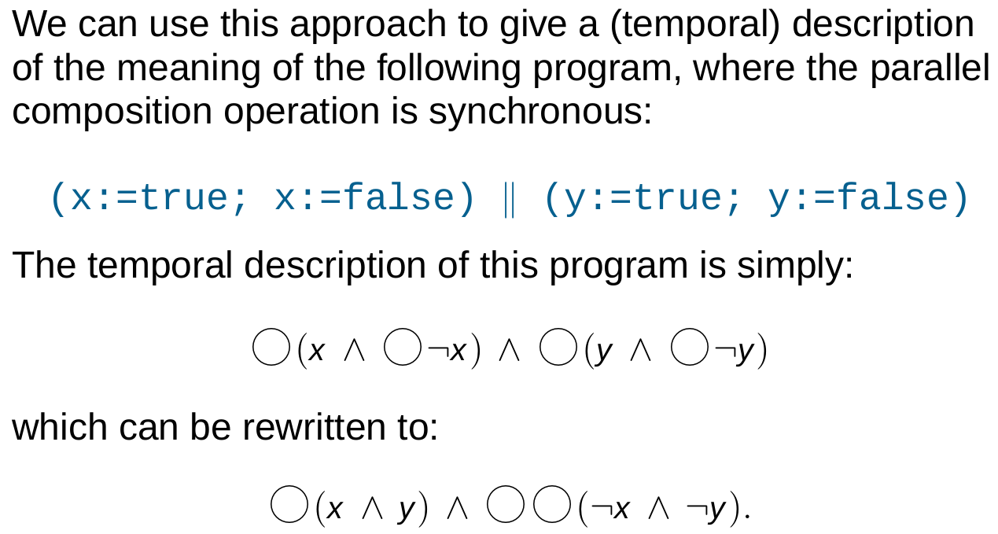
CONCURRENCY - EXAMPLE

Slide 15
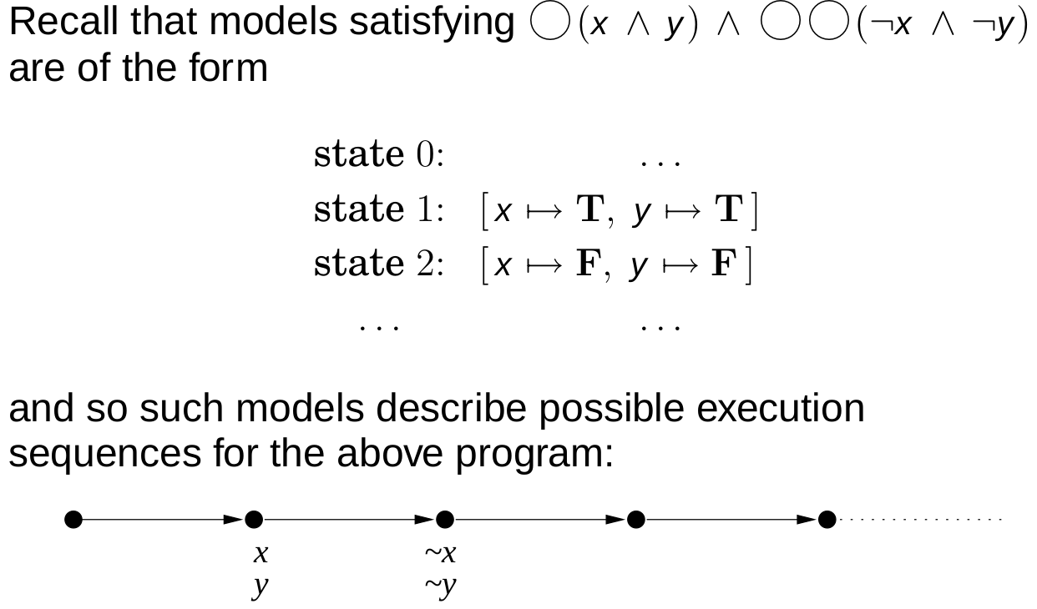
CONCURRENCY – EXAMPLE CONTD.

Slide 16
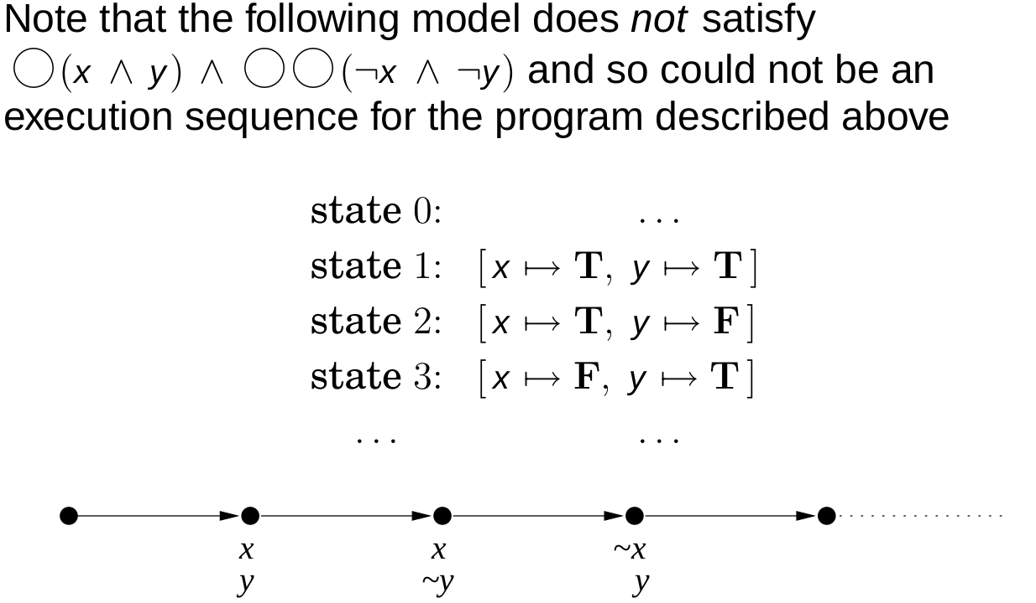
CONCURRENCY – EXAMPLE CONTD.

Slide 17

THANK YOU
Notes:
1

